Slide 1
Open Source Platform and Network Administration
Lesson 11

Slide 3
NFS
Use the root_squash option to ensure requests to filesystem are not given root privileges.
Use the all_squash option for read-only shares.
Use the showmount command to verify that the correct shares are exported or not exported to various clients.

Slide 4
Samba
Is very flexible with its security settings
Can restrict access based on network or host address
Can restrict access and permissions to share for a particular group or list of users
Can be used for workstation and mixed environments with Windows operating system

Slide 5
Enabling Quotas
Step 1
Configure filesystem to allow quotas in /etc/fstab using the command :
/home ext4 defaults,usrquota 1 2
Step 2
Remount the home filesystem using the command :
mount -o remount /home
Step 3
Initialize the quota database using the command :
quotacheck –cm /home
Step 4
Turn quotas on using the command:
quotaon /home

Slide 6
Setting Quotas
Once a directory or a partition becomes 100% full due to downloads, installs, archived data, and even personal music and movies, many processes stop working and can cause an operating system to be unavailable.
Enabling quotas for each user or group, or singling out a single user can prevent many problems.

Slide 7
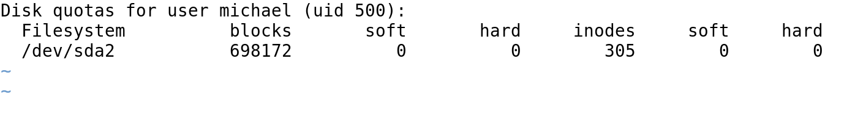
Editing a User Quota

Slide 8
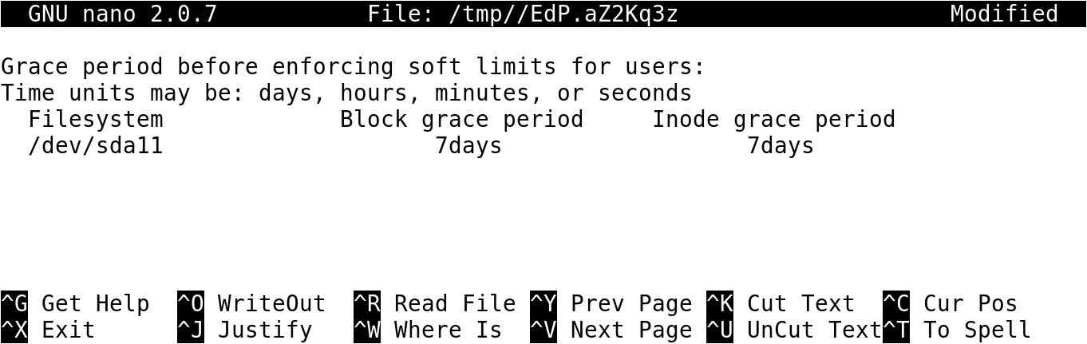
Quota Grace Periods

Slide 9
Filesystems and Access Control Lists
Access control lists (ACLs)
Allow you to set different permissions for specific users and groups
Provide a second level of discretionary access control
ACL support in Linux is mature
ACL support available for the standard Linux filesystems and directories shared through NFS

Slide 10
Linux FHS
It helps users to locate data and files.
Fedora, Ubuntu, and other Linux distributions abide by the FHS.
It would be difficult to work efficiently across various Linux distributions if each distribution followed a completely different standard.
It helps administrators to systematically create and mount various partitions with desired options.

Slide 11
Filesystem Encryption
Stolen or compromised customer data is typically not encrypted.
If any organization's confidential data is compromised, it can have the following repercussions:
The organization’s image is damaged
The organization would be fined
The organization would incur extra cost for fixing the problem later

Slide 12
Securing a Filesystem Using FHS
Format with an appropriate filesystem type.
Confine to read-only if there is no need for users to write or edit data.
Restrict executing files in the /tmp/ directory.
Encrypt directories that contain sensitive data.
Consider using quotas.

Slide 13
Summary
Importance of FHS
Advantages and disadvantages of filesystem encryption
Process to use for securing a filesystem, configuring remote mounting, and enabling quotas
Use of NFS and Samba in Linux

Slide 14
Virtual Lab
Applying Hardened Linux File System Security Controls
Notes:
If your educational institution included the Jones & Bartlett labs as part of the course curriculum, use this script to introduce the lab:
"In this lesson, you learned how to use file and folder permissions to secure the information stored in those locations. You reviewed the common filesystem hierarchy standard directory configuration, discussed how to control access with file and folder ownership and permissions, and were introduced to Linux encryption tools for files, directories, and filesystems.
This lab incorporates security hardening for file systems and user access to mounted file systems. In this lab, you will mount a file system that does not have execute permissions on the CentOS Linux Server. You also will mount a remote file system and set quotas for users of mounted file systems."

Slide 15
OPTIONAL SLIDES

Slide 16
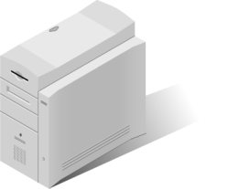
Configuring Remote Mounting
Data server with an Network File System (NFS) share
/etc/exports file on data.is418.local
/share *.is418.local.(ro,all_squash)
data.is418.local
Entry on each client server's /etc/fstab file
Web servers mount the share at boot
data.is418.local:/share /data nfs defaults 0 0

